Slide 1

Displaying Your Favorite Hit Parade with Group Sort
Chapter 9: CR for Dummies

Slide 2
In This Chapter
Sorting groups by performance rather than by name
Selecting by percentage
Sorting groups in reverse
Troubleshooting problems with group sorts

Slide 3
Why Sort groups by performance rather than by name
An old saying in the sales business is that you get 80 percent of your sales from 20 percent of your customers. It’s called the Pareto Principle or the 80/20 rule, and it’s not restricted to sales.
Some people or things are more productive than others doing the same work. If you identify the most productive salespeople, machinery, or whatever, you can analyze the factors that make them so effective and perhaps apply what you learn to increase productivity overall.

Slide 4
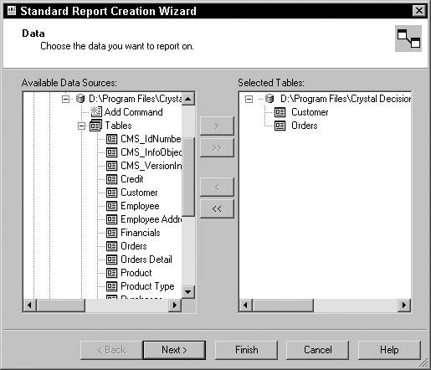
Create a new Report (Top5USA)
Vice President of Sales, is trying to get a feel for which customers are buying the most.
A Top N report is probably your best choice. To build one, follow these steps:
Choose the Report Wizard, select Standard, and then click OK.
The Standard Report Creation Wizard appears.
Find the xtreme database, and then select the Customer and Orders tables, as shown

Slide 5
Now …
Click Next to display the Link view.
You see the Customer table connected to the Orders table by the Customer ID field.
Click Next to display the Fields view.
Move Customer Name, Region, and Order Amount to the Fields to Display pane.
Click Next to display the Grouping view.
The Vice President of Sales wants to list the five top U.S. customers, along with their states and the total amount of their orders. The easy way to do this is to group the records by Customer ID, hide order detail, sort by the sum of the order amount for each customer, and include the top five customers in the report.

Slide 6
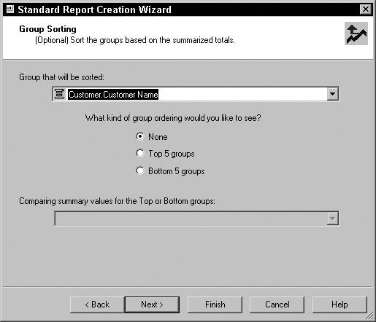
Sounds easy, lets start with …
Move Customer.Customer Name to the Group By pane and specify descending order.
This puts the customer with the highest total first.
Click Next to display the Summaries view.
In the Summarized Fields pane, specify Sum of Orders.Order Amount. In the pull-down list below that pane, specify Sum.
Click Next to display the Group Sorting view, shown below.

Slide 7
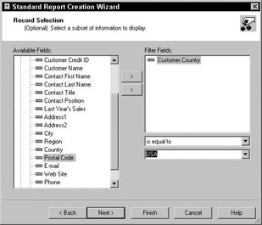
Next …
Select Top 5 Groups. In the Comparing Summary Values for the Top or Bottom Groups pull-down list, select Sum of Orders.Order Amount.
Click Next to display the Chart view, and then click Next again to display the Record Selection view.
You’re interested in only U.S. sales at present, so fill out the Record Selection view, as shown

Slide 8
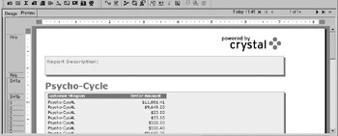
Finish up with …
Click Next to display the Template view.
Select a template for the report.
Use Standard.(We don’t have the same template ‘Block’)
Click the Finish button.
Crystal Reports builds your report and it appears on-screen, as shown (Theirs)

Slide 9
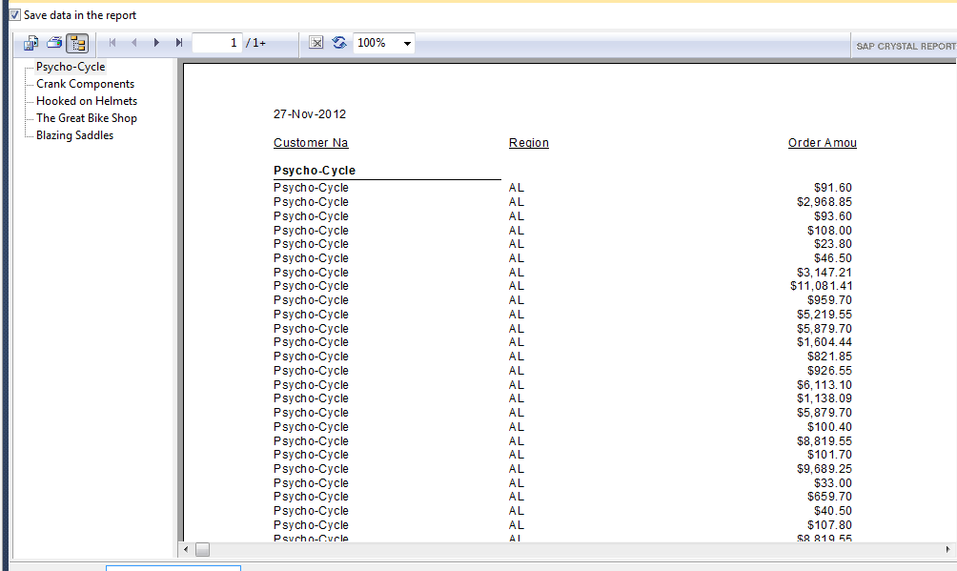
Ours

Slide 10
Still needs work …
It’s not exactly what the Vice President of Sales had in mind. We need to make the following adjustments:
Give the report a title.
Change the Region column heading to State, and center the state data under it.
Delete the repeated customer name entries in the detail lines.
Space the columns out horizontally.
Hide the individual entries for each order.
(Display the sum of the orders for each displayed customer. Without lines. )

Slide 11
To make the needed adjustments, follow these steps:
Switch to Design mode.
On the Insert Tools toolbar, click the Insert Text Object icon.
Type Top Five USA Customers inside the newly placed text field.
Expand the text field and center it. Increase the font size of the text to 14 to make the heading easier to read.
Change the Region column heading to State and center the two-character state abbreviations below it.
Remove the Customer Name column. Because the customer name appears in the group header, there is no need to repeat it in the detail area.
Report should look like this

Slide 12
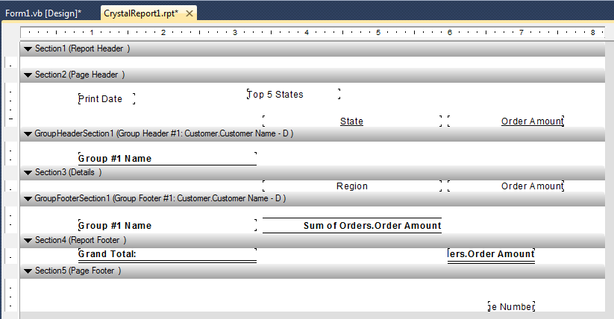
Design View to date

Slide 13
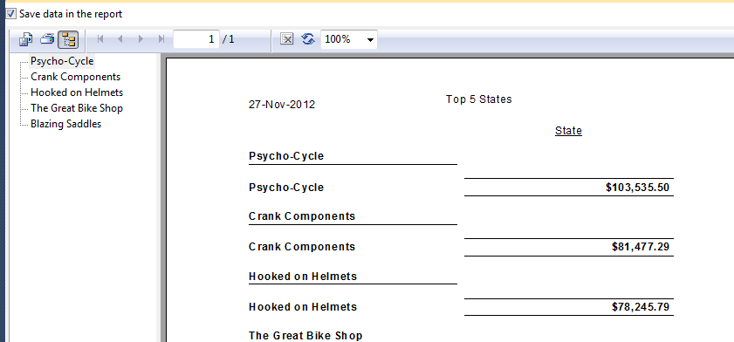
Next Step
The next thing you might want to do to produce a summary report for a top executive is to hide all the detail lines:
Right-click in the area to the right of the Details section and choose Hide (Drill-Down OK).
The report now looks like this.

Slide 14
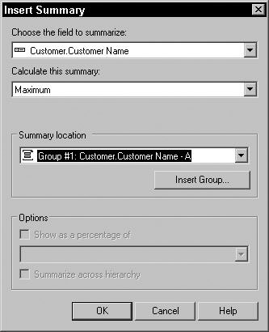
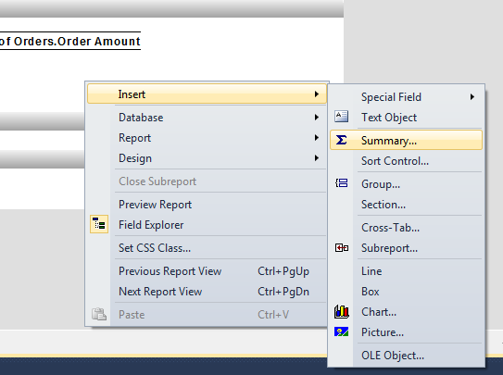
The next thing to do is display a group total in the Group Footer section:
Remove the lines on the sum and align/size with the title.
Remove the group name.
Add the summary information in the group section
Right click – insert - summary
Fill in dialogue as shown
The Insert Summary dialog box appears.

Slide 15
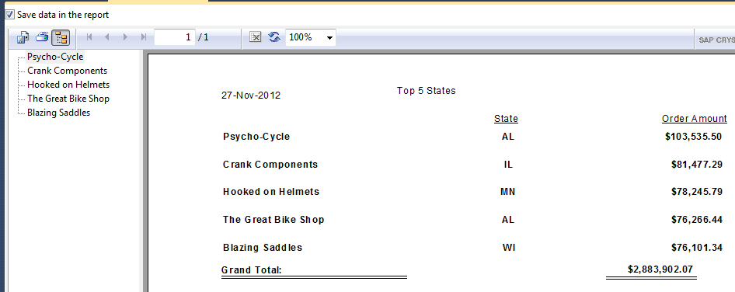
Add state data
Repeat Steps for the Customer.Region field to insert it below the State heading.
With the Region still selected, click the Align Center icon to center the state abbreviation below the State heading.
Delete the Customer.Customer Name. This leaves each group with all the information you want and none of the extra stuff you don’t want to display.
Hide the Group Header section as above.
Your report looks as below.

Slide 16
Going with the Percentages
Sometimes it’s more helpful to know who is responsible for the largest percentage of an organization’s total sales rather than the specific dollar amount. The Group Sorting screen of the Standard Report Creation Wizard handles summaries expressed as percentages as well as straight numbers. You could build a report from scratch, similar to the one you built in the preceding section, by following most of the same steps, with just a slight difference at the summarization step.
Rather than going through all that again here, though, you can modify the completed report to display percentages rather than group totals. Just follow these steps:

Slide 17
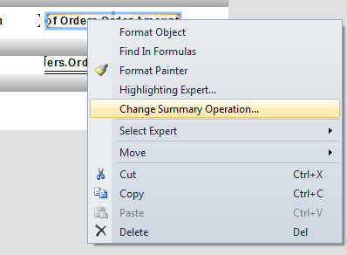
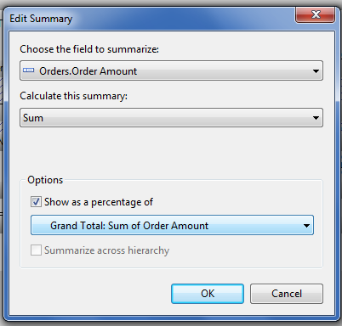
Change to a %
In Design mode, right-click the Sum of Orders.Order Amount field in the Group Footer #1 section.
Choose Edit Summary.
Select the Orders.Order Amount field to summarize; calculate the Sum summary, and select the box to the left of Show as a Percentage of.
The drop-down list below the Show as Percentage of line holds the value you want ( Grand Total: Sum of Order Amount).

Slide 18
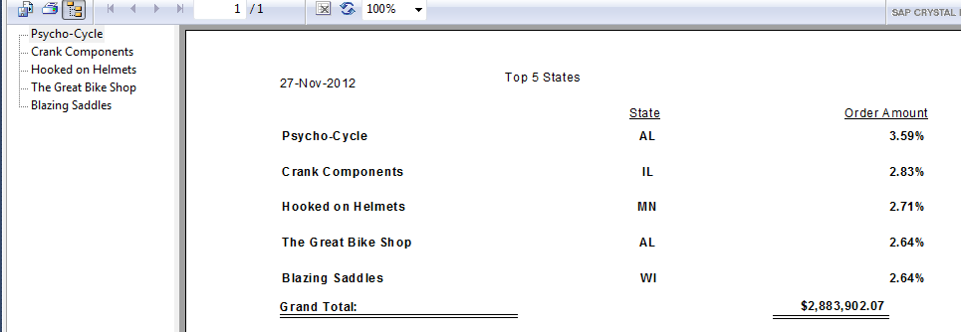
Top 5 is about 15%
Now when you switch to Preview mode, you see the report shown below. The five top customers are listed along with their percentage of Xtreme’s total sales. This report tells you something that you didn’t get from the previous report: The top five customers combined account for less than 15 percent of Xtreme’s orders. Looks like Xtreme is in the healthy position of not depending too much on a small number of customers. Sales volume is distributed over a large customer base.

Slide 19
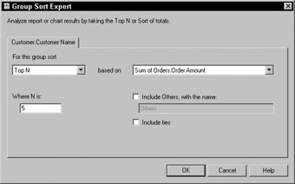
What if you want the top seventeen instead of the top five?
The group sort used here to produce the latest reports happened to ask for the top five customers. Okay, that’s suspiciously convenient; the Standard Report Creation Wizard gives you the option of selecting the top five or bottom five — but not the top ten, top seventeen, and so on. If you want your report to return some number of groups other than five, use Group Sort Expert.
When you click the Group Sort Expert icon on the Expert Tools toolbar, the Group Sort Expert dialog box appears, as shown

Slide 20
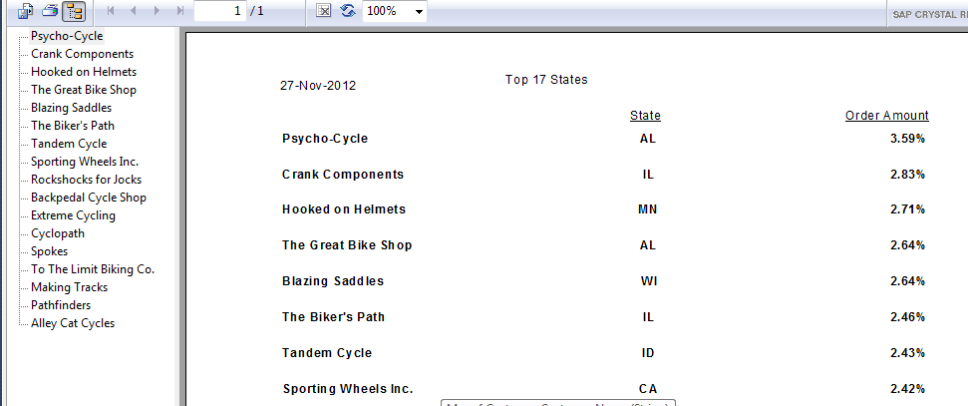
Final step
The default values for the current report are shown. The type of sort is Top N, based on Sum of Orders.Order Amount, where N is 5. If you want to see the percentage sales of the top 17 customers instead of the top 5, just replace the 5 with a 17 in the Where N Is box, and then click OK.
The only task that remains to make this a complete report is to change the references to Five in the page header to Seventeen.

Slide 21
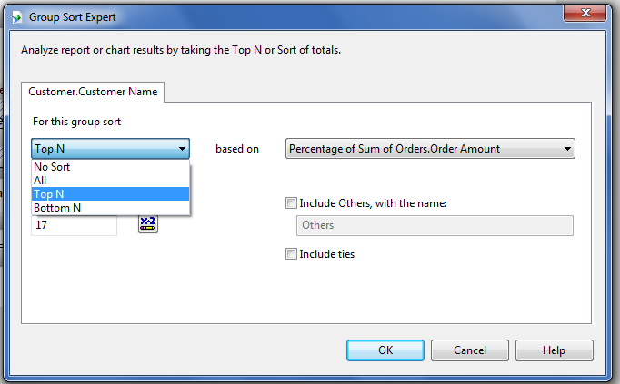
Choice of Group Sorts
You have probably guessed from what you have seen so far, that everything you can do for the top performers, you can also do for the bottom. Take a closer look at the Group Sort Expert dialog box. shows it with the group sort list pulled down. The options on this menu are No Sort, All, Top N, Bottom N, Top Percentage, and Bottom Percentage.

Slide 22
Other options
You have already seen what Top N does. Bottom N does the same thing, but for the tail-enders rather than the leaders. The other four options require a little explanation.
The No Sort option does what it says: nothing. It leaves the lines of the report in the order in which the corresponding groups appear in the database. You might wonder why this option even exists. One reason might be that you want to build a new report based on an existing one, but the existing report is sorted. If you want your new report to reflect the order of the records in the database rather than the sort order of the old report, one way to get what you want is to use the No Sort option.
The All option sorts and displays all the groups, not restricting the display to any given number. A report built according to this option would contain all the data of a Top N report, plus all the data of a Bottom N report, plus data on all the groups not included in either of those.
With the Top Percentage group sort, you specify the top percentage that you want to see in the report. For example, if you wanted to see whether the 80/20 rule applies to your organization, specify a Top Percentage group sort, and enter 80 in the Where Percentage Is box. If you have, for example, 90 customers, the 80/20 rule holds if the report lists about 18 customers ( representing 20 percent of the total).
To report on the customers who order the least amount of product, use the Bottom Percentage group sort. For Xtreme Mountain Bikes, the companies in this report need help or should be replaced by companies that can do a better job.

